Slide 1
Sprint 3 Data Flow
Team WetBlock

Slide 2
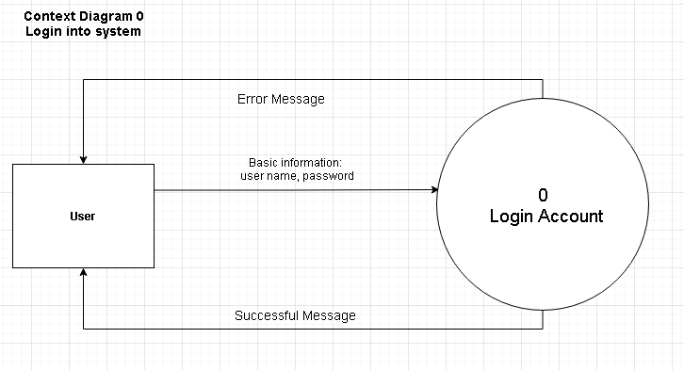
Login Context Diagram 0

Slide 3
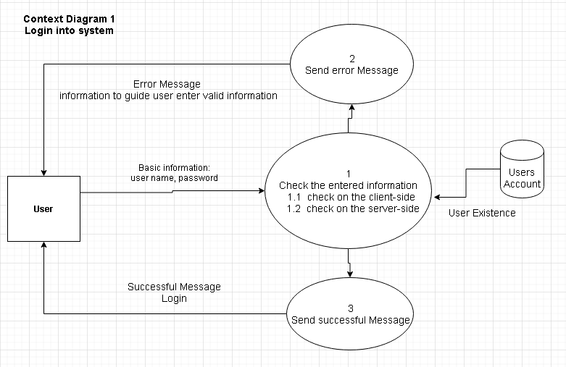
Login Context Diagram 1

Slide 4
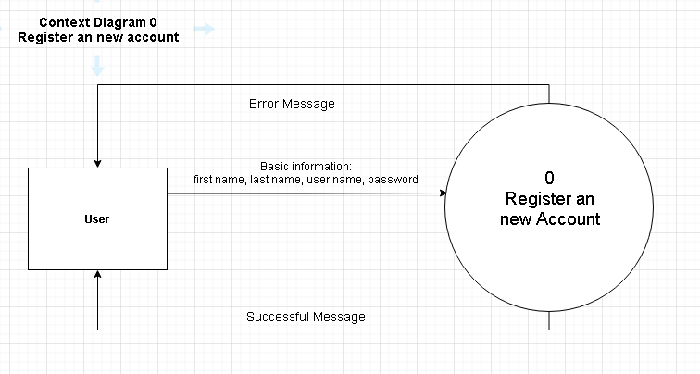
Registration Context Diagram 0

Slide 5
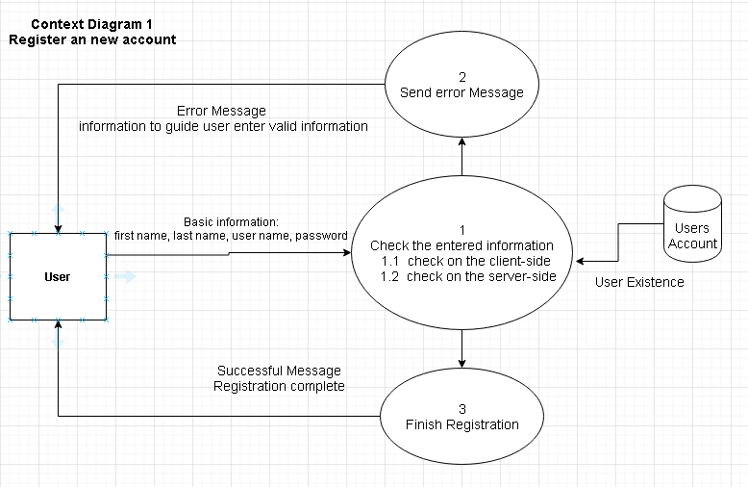
Registration Context Diagram 1

Slide 6
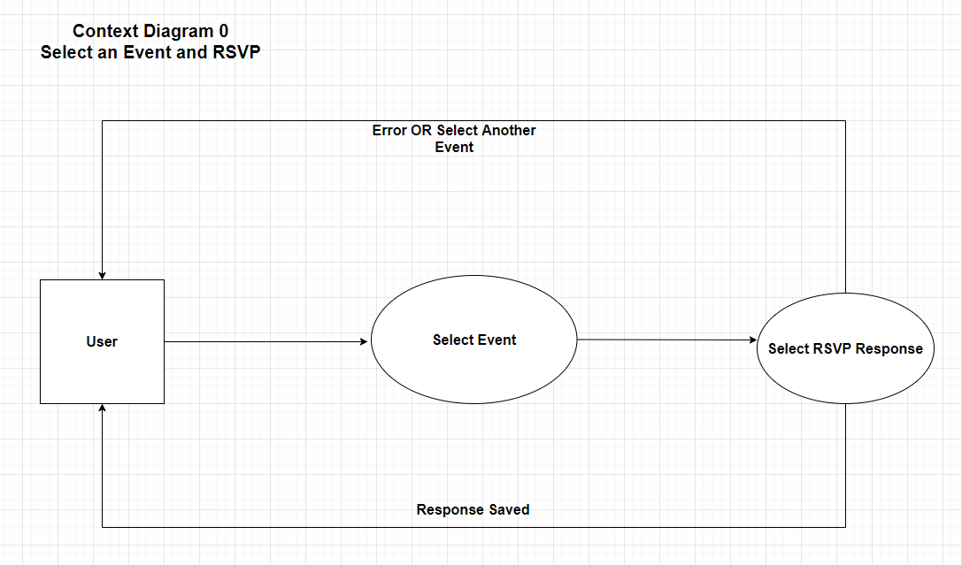
Event Selection & RSVP Context Diagram 0
RSVP?

Slide 7
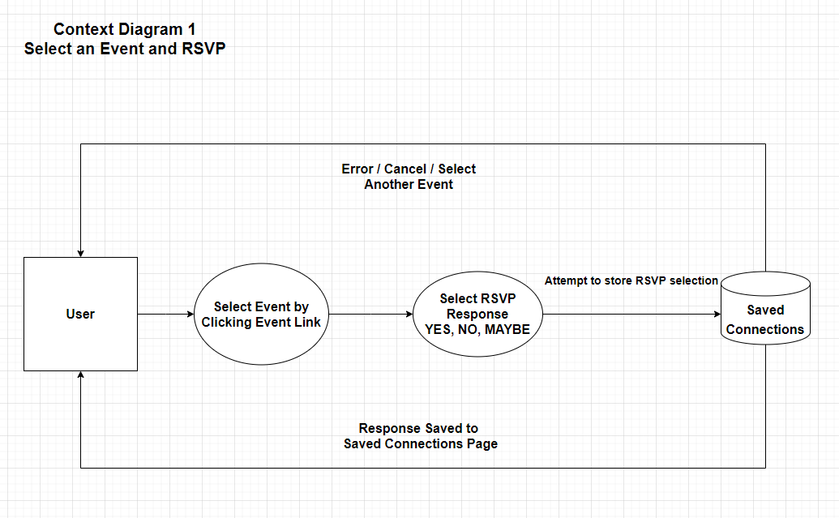
Event Selection & RSVP Context Diagram 0

Slide 8
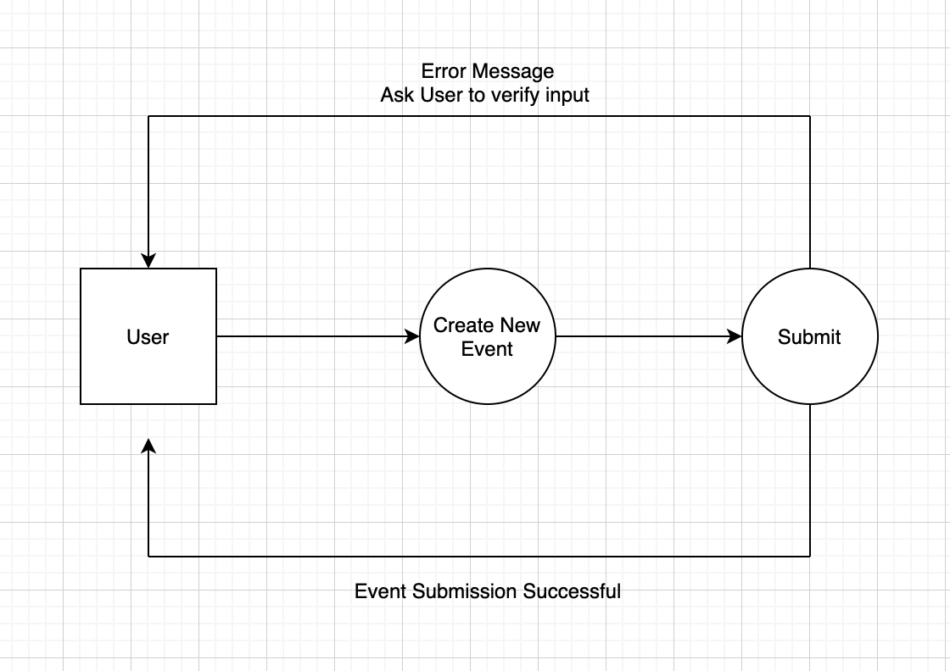
Adding New Events- Context Diagram 0

Slide 9
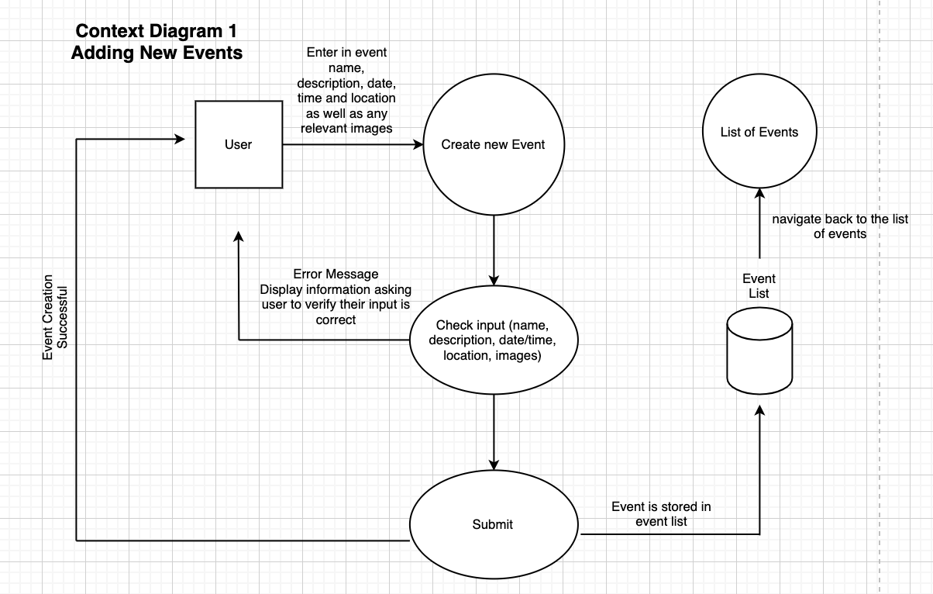
Adding New Events- Context Diagram 1
Notes:
Andy:
Server side:Validation data by python.
Browser side: We do not need to check using javascript.
Keep the logic on the server side.
In the check input, check the requirement field like name, date/time, location. If the everything is good, the system send the valid data to the server, and save the event to database. Otherwise, it raise an error message back to user. After storing new event, the system go back to the list of events.

Slide 10
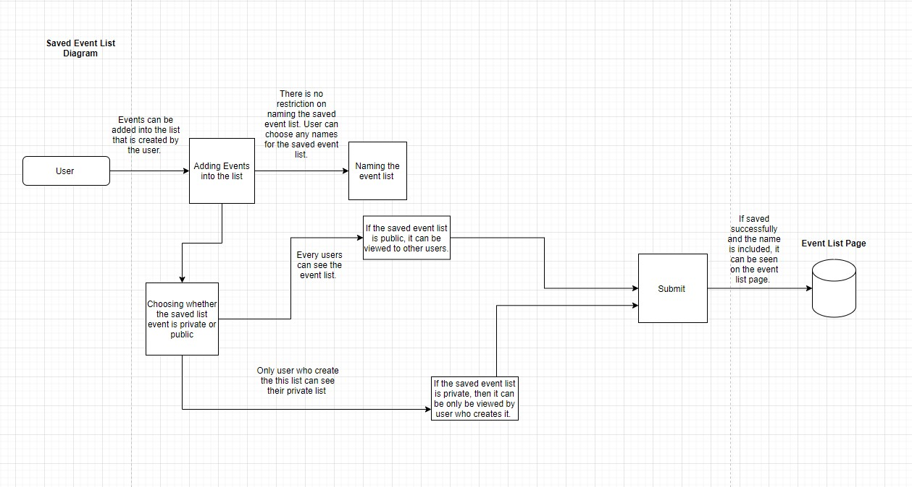

Saved Event List Diagram 0
Add event to favourite list
View the favourite list
/save

Slide 11
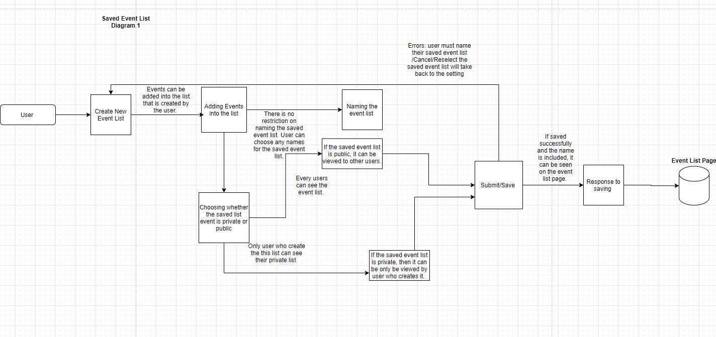
Saved Event List Diagram 1

